Slide 1
CS 5402 Introduction to Data Mining
Basic Technique - 1R
v.1
Perry B. Koob, koobp@mst.edu

Slide 2
What we are going to learn.
Supervised Learning
Overfitting
Classification
1R
Discretization

Slide 3

https://scikit-learn.org/stable/tutorial/machine_learning_map/index.html

Slide 4
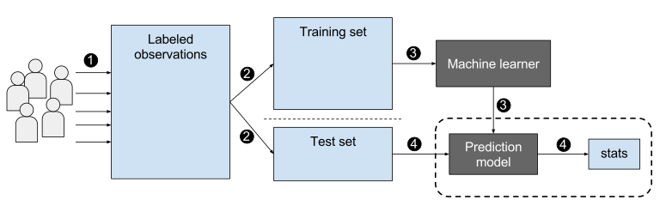
Supervised Learning
https://upload.wikimedia.org/wikipedia/commons/0/09/Supervised_machine_learning_in_a_nutshell.svg

Slide 5
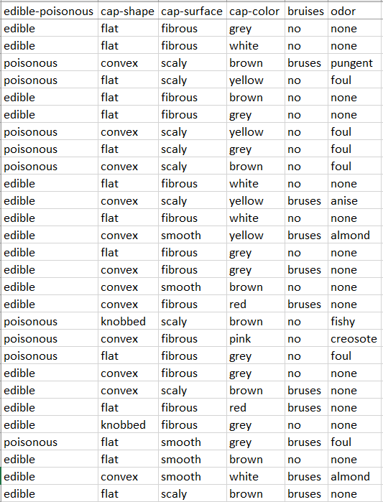
Supervised Learning
Attributes
Class
Or
Label
Collected Data
The Collected Data or a subset of the Collected Data is a Data Set.
A Data Set is comprised of multiple Examples or Instances.
The Data Set can be a Sample or a Population.

Slide 6
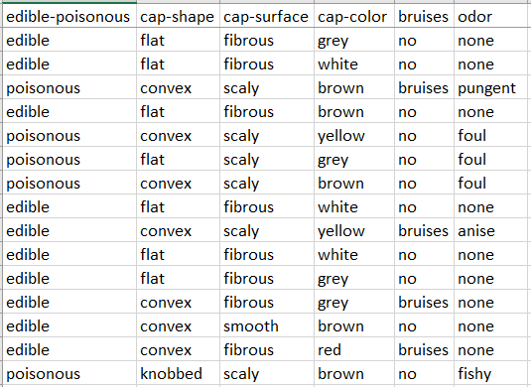
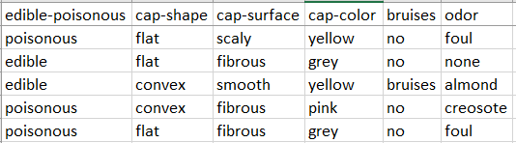
Supervised Learning
Training Set
Randomly
Selected
Partitioning
Testing Set

Slide 7
Supervised Learning
Training Set
Randomly
Selected
Partitioning
Common to see:
80% Training
20% Testing
or
70% Training
30% Testing
Testing Set

Slide 8
Supervised Learning
Training Set
Randomly
Selected
Partitioning
Testing Set
Validation Set

Slide 9
Random vs. Representative Sampling
Random sample will use randomization to partition the data into different sets. The larger the data set the more the partitions will be similar.
Representative sample will use measures to make sure the sample properly represents the characteristics of the data set.

Slide 10
Supervised Learning
Model Training
Training Set
Trained Classification Model
Testing Set

Slide 11
Supervised Learning
Machine Learner
Model Training
Training Set
Trained Classification Model
Prediction Model
Testing Set

Slide 12
Supervised Learning
Compare the results from the model to the known labels.
Training Set
Trained Classification Model
Run the Test Set through the model.
Testing Set

Slide 13
Supervised Learning
Model Evaluation
Compare the results from the model to the known labels.
Training Set
Trained Classification Model
Run the Test Set through the model.
Testing Set

Slide 14
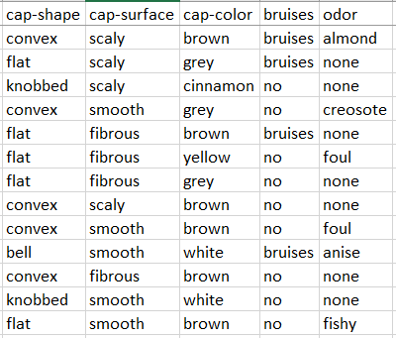
Classification
Training Set
Testing Set
New Data
edible
Trained Classification Model
non-edible

Slide 15
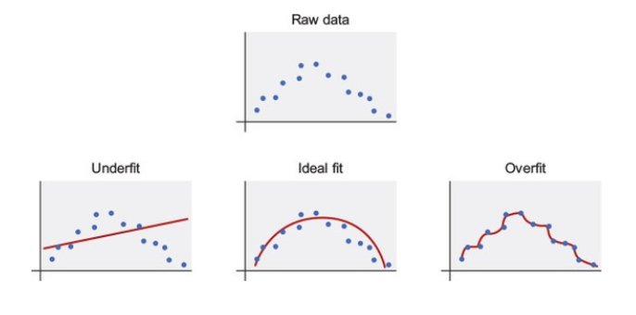
The Fit of a Model
Underfitting is when you build a poorly performing model.
Overfitting is when you build a model that performs really well on the training data set, but performs poorly on new data sets. This can happen with too many rules or too many attributes.
@nickbortolotti

Slide 16
The Fit of a Model

Slide 17
1R or 1-Rule Classifier
Holte, R. C. (1993). Very simple classification rules perform well on most commonly used datasets. Machine learning, 11(1), 63-90.
This is the simplest Classifier.
Meant to show a simple classifier is still valuable.
Parsimonious model = a model that achieves the desired level of prediction with a few attributes as possible.

Slide 18
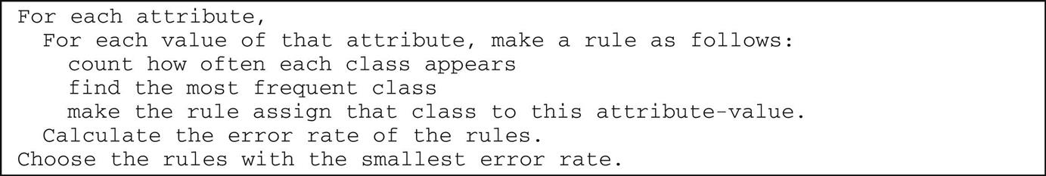
1R or 1-Rule Classifier
We will create 1 set of Rules that operate on 1 Attribute.
1R is a binary classifier: True or False, Play or Not Play, Edible or Not Edible.
1R works with Nominal attributes.
Algorithm:

Slide 19
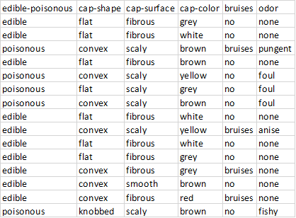
1R Classifier
Take the Training Data Set.
Make a set of initial rules based on which class appears the most with the attribute label.
For each Attribute
For each Value
Determine the frequency of the label
Determine the frequency of a class

Slide 20
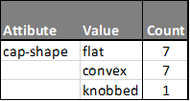
1R Classifier - Label Freq.
Take the Training Data Set.
Make a set of initial rules based on which class appears the most with the attribute label.
For each Attribute
For each Value
Determine the frequency of the label
Determine the frequency of a class

Slide 21
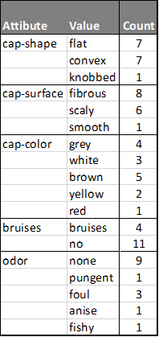
1R Classifier - Label Freq.

Slide 22
1R Classifier - Class
We are going to classify the Mushrooms, which are already labeled as Edible and Poisonous, as Edible and Non-Edible.

Slide 23
1R Classifier - Class Freq.
Get a count of the Class that appears with each Attribute Value.

Slide 24
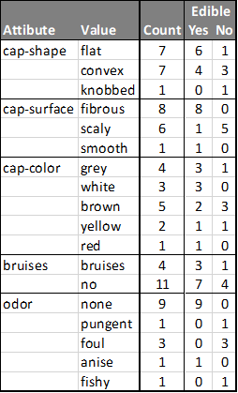
1R Classifier - Class Freq.

Slide 25
1R Classifier - Rules
Create Rules based of off higher Class Frequency.
Ties broken by arbitrary selection.

Slide 26
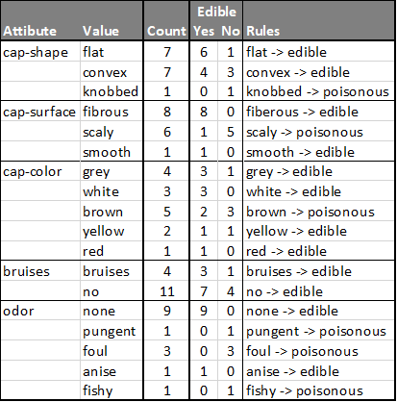
1R Classifier - Rules

Slide 27
1R Classifier - Errors

Slide 28
1R Classifier - Error
Determine the number of Examples incorrectly classified by an Attribute's Rule Set.

Slide 29
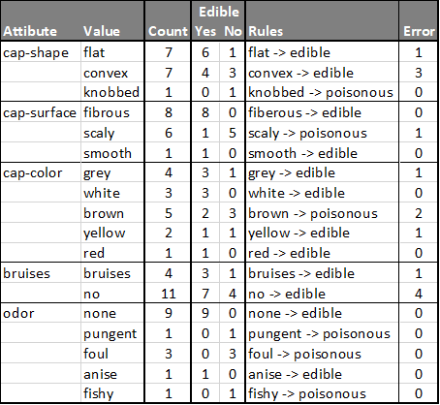
1R Classifier - Errors

Slide 30
1R Classifier - Error Rate
To determine the Error Rate of a Attributes Rule Set
Sum Errors
Error Rate = --------------------------------------------------------
Number of Examples
https://classeval.wordpress.com/introduction/basic-evaluation-measures/

Slide 31
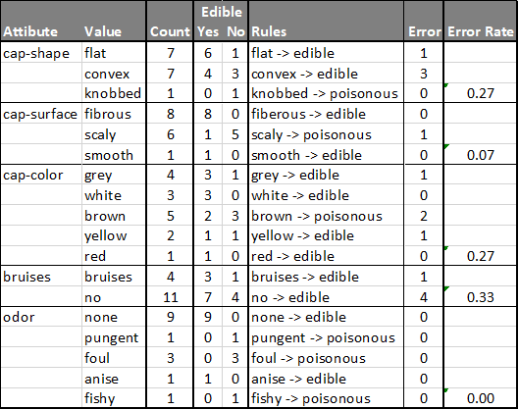
1R Classifier - Error Rate

Slide 32
1R Classifier - Pick the Best Rule Set
Pick the Rule Set with the lowest error. In case of a tie, arbitrarily choose one of the tying rule set.
1R Classifier Rule Set:
none -> edible
pungent -> poisonous
foul -> poisonous
anise -> edible
fishy -> poisonous

Slide 33
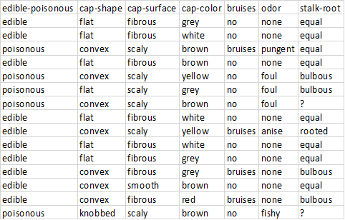
1R Classifier - Missing Values
If you encounter Attributes with missing values, treat them like they are another
Value of the Attribute.

Slide 34
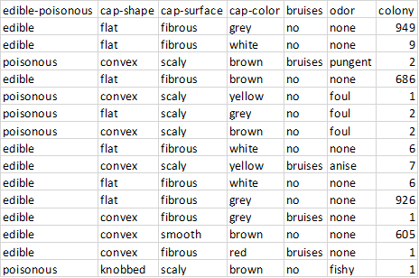
1R Classifier - Discretization

Slide 35
1R Classifier - Discretization
Discretization is the process of converting a continuous Attribute into a Nominal Attribute by putting them into a limited number of buckets.
Buckets are to hold 3 or more examples if less than 50 instances.
Buckets are to hold 6 or more examples if more than 60 instances.

Slide 36
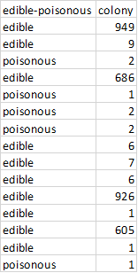
Discretization
From (Manning, Holmes, & Witten 1995).
Sort the tuples by attribute value.
Form intervals by placing a split point between every pair of different values.
Repeat until there are no more split points.
remove split points between intervals that predict the same class,
examine the decrease in accuracy which would result from removing each split point,
remove the least costly split point (in the event of a tie, choose one at random);
Choose the best split point on the accuracy vs number of splits curve.

Slide 37
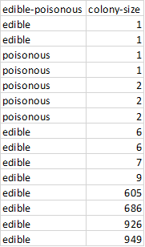
Discretization
From (Manning, Holmes, & Witten 1995).
Sort the tuples by attribute value.
Form intervals by placing a split point between every pair of different values.
Repeat until there are no more split points.
remove split points between intervals that predict the same class,
examine the decrease in accuracy which would result from removing each split point,
remove the least costly split point (in the event of a tie, choose one at random);
Choose the best split point on the accuracy vs number of splits curve.

Slide 38
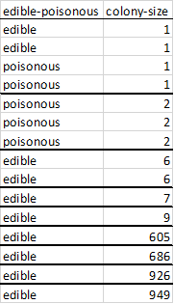
Discretization
From (Manning, Holmes, & Witten 1995).
Sort the tuples by attribute value.
Form intervals by placing a split point between every pair of different values.
Repeat until there are no more split points.
remove split points between intervals that predict the same class,
examine the decrease in accuracy which would result from removing each split point,
remove the least costly split point (in the event of a tie, choose one at random);
Choose the best split point on the accuracy vs number of splits curve.

Slide 39
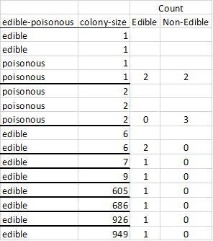
Discretization
From (Manning, Holmes, & Witten 1995).
Sort the tuples by attribute value.
Form intervals by placing a split point between every pair of different values.
Repeat until there are no more split points.
remove split points between intervals that predict the same class,
examine the decrease in accuracy which would result from removing each split point,
remove the least costly split point (in the event of a tie, choose one at random);
Choose the best split point on the accuracy vs number of splits curve.

Slide 40
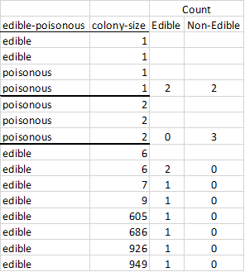
Discretization
From (Manning, Holmes, & Witten 1995).
Sort the tuples by attribute value.
Form intervals by placing a split point between every pair of different values.
Repeat until there are no more split points.
remove split points between intervals that predict the same class,
examine the decrease in accuracy which would result from removing each split point,
remove the least costly split point (in the event of a tie, choose one at random);
Choose the best split point on the accuracy vs number of splits curve.

Slide 41
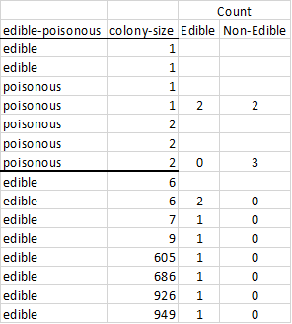
Discretization
From (Manning, Holmes, & Witten 1995).
Sort the tuples by attribute value.
Form intervals by placing a split point between every pair of different values.
Repeat until there are no more split points.
remove split points between intervals that predict the same class,
examine the decrease in accuracy which would result from removing each split point,
remove the least costly split point (in the event of a tie, choose one at random);
Choose the best split point on the accuracy vs number of splits curve.

Slide 42
Discretization
If colony-size > 2, then edible.
If colony-size <= 2, then non-edible.
Error rate of 2 of 15, or 0.13 .

Slide 43
What we covered.
Supervised Learning
Overfitting
Classification
1R
Discretization

Slide 44
References
Holte, R. C. (1993). Very simple classification rules perform well on most commonly used datasets. Machine learning, 11(1), 63-90.
Nevill-Manning, C. G., Holmes, G., & Witten, I. H. (1995, November). The development of Holte's 1R classifier. In Proceedings 1995 Second New Zealand International Two-Stream Conference on Artificial Neural Networks and Expert Systems (pp. 239-242). IEEE.
Witten, I. H., Frank, E., Hall, M. A., & Pal, C. J. (2016). Data Mining: Practical Machine Learning Tools and Techniques.

